Slide 1
How To Find Success At The
Concert MPA With A
“Limited Instrumentation”
Ensemble
Presented by
Ms. Kelly Dorsey, Union County High School
Mr. Ivan Wansley, Clinician/Conductor/Adjudicator
January 13, 2017
Sponsored by The American School Band Director’s Association
Notes:
Joe

Slide 2
Be smart from the beginning
Start kids on instruments at the end and/or the beginning of the school year to fill out instrumentation for the future.
Offer candy, pizza or extra credit. In reality we are getting them to invest in the program.
Ex: move saxes to bassoon or oboe, flute to tuba, saxes to baritone/trombone.
It can be done, you just HAVE to do it!
However, if you do not have tubas, you still have to fill the band sound from the bottom up.
Notes:
Kelly

Slide 3
Scoring options
Look for pieces with block scoring. Ex: no more than 2 tpt/cl. parts, 1 horn part, no more than two different low voice parts.
You can change scoring but not voicing.
Take all 1st clarinets down an octave but leave one player up.
Double parts
If your lower part players cannot handle, do not be afraid to re-assign.
Ex: If 1st part player is silent, they can cover a 3rd part
Notate changes in score. Don’t allow the judges to guess what you are doing, make sure they KNOW what you are doing.
Notes:
Kelly

Slide 4
Chordal Analysis
Chordal analysis should happen at least at the transition, cadence points, and areas of accidentals.
Fillmore/Bennett, Sousa, and King marches include the following in their chord scoring:
85% voices on the root
14% voices on the 5th
1% voices on the 3rd - This MUST be changed! The 3rd determines the quality of the chord.
Tip:
One way to make your ears better is to make a piano reduction score and play it
If there is something on the score you see and don’t hear, STOP and focus on it!
Notes:
Ivan

Slide 5
Interchangeable instrumentation
Oboe solo - muted trumpet - clarinet
Trombone - Baritone - French Horn - Bassoon - Tenor Sax - Bass Clarinet
Tuba - Bari Sax - Bass Clarinet
Clarinet - Trumpet
Alto Sax - French Horn
Flute - Oboe
Split clarinet parts to help the French Horns or Trumpets
Have a Baritone play the 2nd or 3rd trombone part
Tip:
Be sure the voicing is correct when interchanging parts
Study Marching Band scores to view simple similarities
Notes:
Kelly

Slide 6
Transpositions
Transposing instruments finger higher than they sound with the exception of the piccolo which sounds an octave higher than it fingers and the Eb Soprano Clarinet which sounds a minor third lower than it fingers.
.
Bb Family | Major 2nd | Major 2nd + octave | Major 2nd + 2 octaves
 | Clarinet | Tenor Saxophone | Bb Contra Clarinet
 | Soprano Sax | Bass Clarinet
 | Trumpet | Baritone Treble Clef
Eb Family | Down a minor 3rd | Major 6th | Major 6th + octave
 | Eb Soprano Clar. | Alto Sax | Bari Sax
 |  | Alto Clarinet | Eb Contra Clarinet
F Family | Perfect 5th
 | French Horn
 | English Horn
Tip:
Bari Sax can read Tuba parts as long as they change the key signature and the clef sign.
Notes:
Ivan

Slide 7
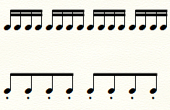
Rhythmic Changes
Original rhythm
Change to
Notes:
Kelly

Slide 8
Non-Traditional Seating - Seating For Success
Why do the Tubas have to sit on the back row and why do the Flutes have to sit on the front row?
Euphoniums sitting in the middle of the band.
Clarinets sitting on front row
Flutes sitting on the second row.
Try to put saxophones behind the French Horn
French horns should not sit in front of bell front brass i.e. tpts and tbns.
Put French horns on the left instead of the right.
If an exceptional player is over balancing the section, place them in the middle of the band. For ex: if only three clarinets, but the1st player is exceptional, place them behind the other two.
Why do tubas have to sit on the back row? What about the middle of the 2nd row?
Notes:
Ivan

Slide 9
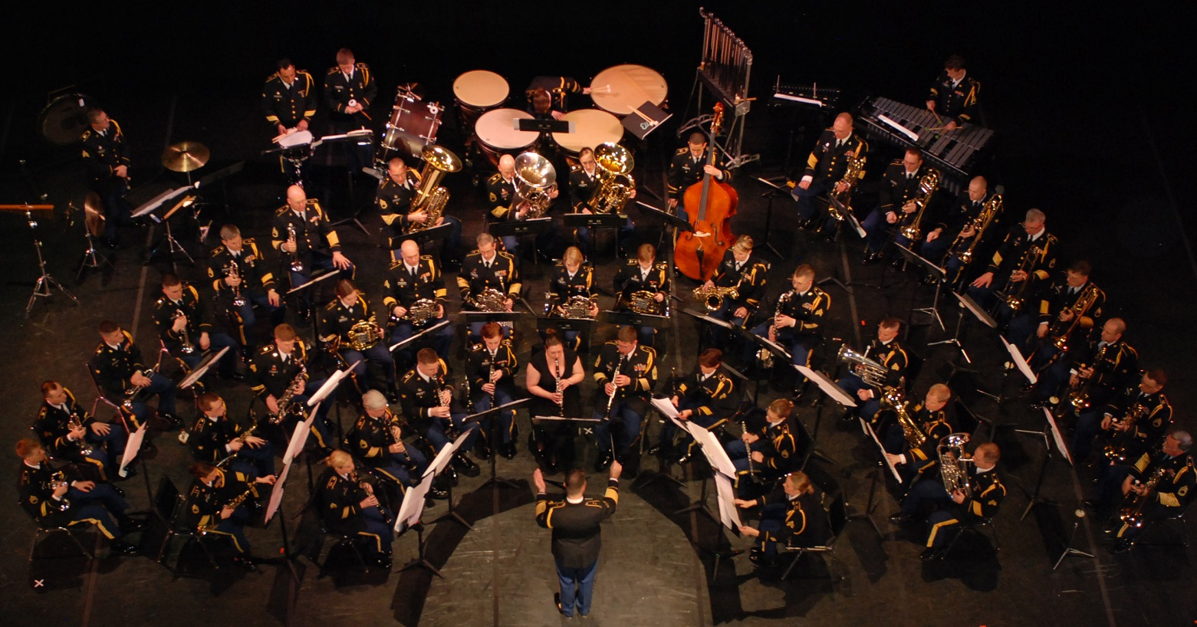
Non-Traditional Seating - Seating For Success
SEAT YOUR BAND HOWEVER YOU NEED TO SO IT WILL WORK FOR YOU.

Slide 10
Score Preparation
•Score Rehearsal Preparation: A Realistic Approach for Instrumental Conductors by Gary Stith
•We should all strive to become better conductors for our students. It is our responsibility to become the music. We need to visually show them the music.
•Watch YouTube Videos of great conductors.
Ex: Carlos Kleiber (Beethoven Sym. #4 and #7)
•Attend Conducting Symposiums
•Attend All-State Rehearsals with the intention of watching conductors
•Attend your Concert MPA’s to listen to bands and watch conductors.
Notes:
Ivan

Slide 11
Suggested Literature
•Of Emerald Shires – Myers
•All the Pretty Little Horses – McGinty
•Air and Alleluia – Mozart/Kinyon
•Shaker Variants – Del Borgo
•Sea Song Trilogy – McGinty
•Sea Song Fantasy – McGinty
•Two Scottish Dances - Vinson
Notes:
Ivan

Slide 12
Auburndale High School Band
Hannah Haugen, Director
Demographics
1 High School - 1180 Student population
1 Middle School - 800 Student population
Some private and charter schools but no band programs
Main Industry is Citrus and Farming
Located off I-4 between Tampa and Orlando
Notes:
Kelly

Slide 13
Auburndale High School Band
Hannah Haugen, Director
Instrumentation of Ensemble
One third of the band is currently playing a different instrument than they played in Middle School.
3 Flutes - One 1st, two 2nd’s.
No Oboes
4 Clarinets - One 1st, One 2nd, Two 3rd’s.
1 Bass Clarinet
2 Alto Saxes - One 1st, One 2nd
1 Tenor Sax
No Bari
No Bassoons
4 Trumpets - One 1st, One 2nd, Two 3rds
2 Trombones - One 1st, One 2nd
3 Baritones
3 Tubas
6 Percussion
8 - 9th Graders
7 - 10th Graders
9 - 11th Graders
6 - 12th Graders
Notes:
Ivan

Slide 14
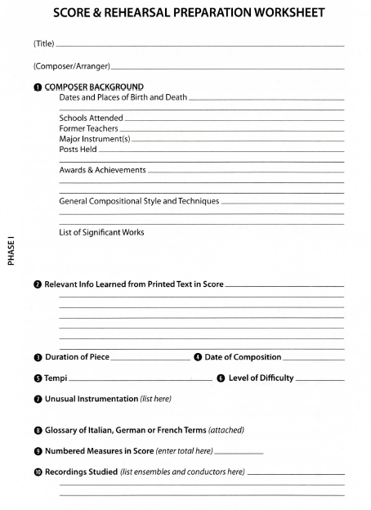
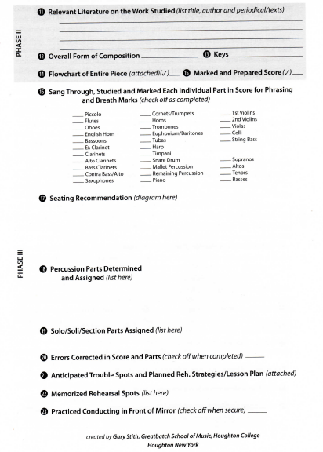
Notes:
Kelly

Slide 15
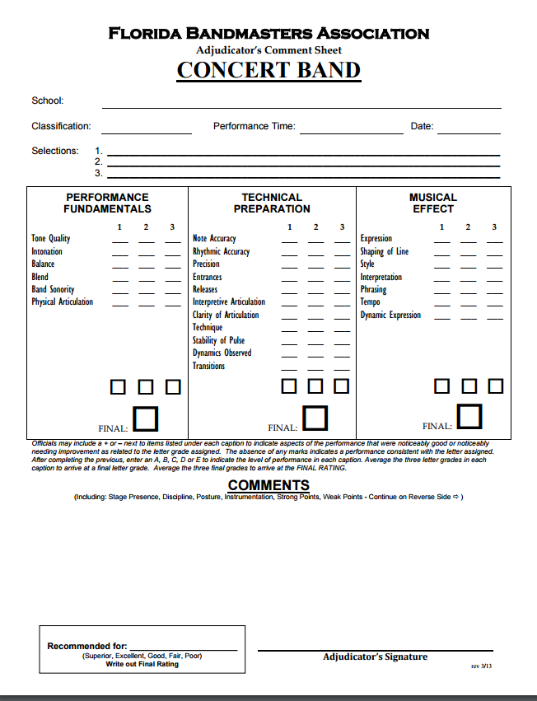
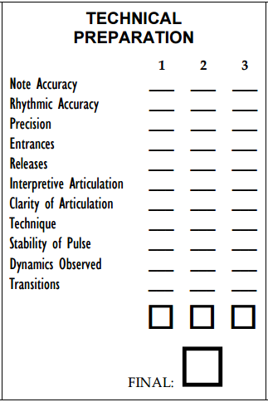
Notes:
Kelly

Slide 16
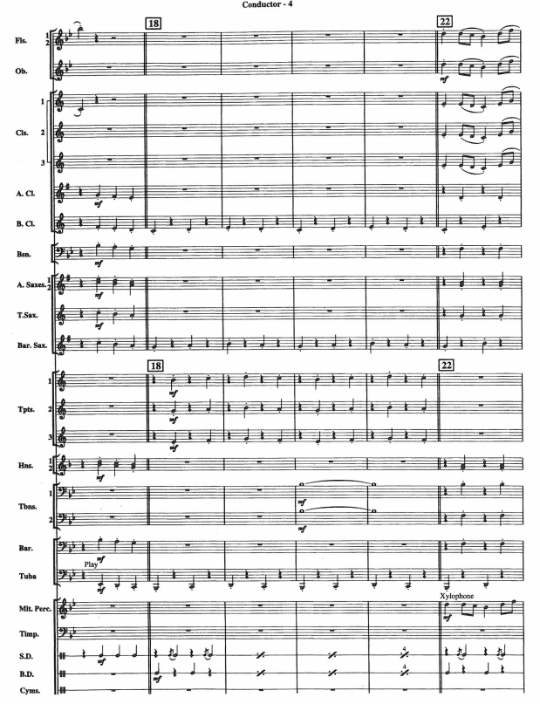
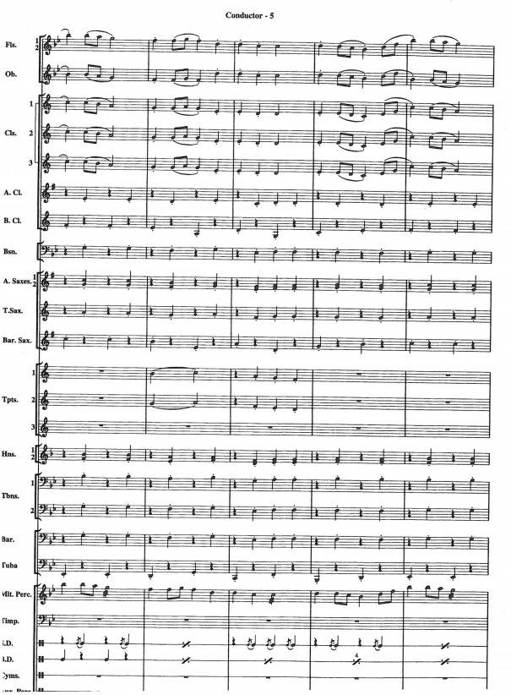

Slide 17
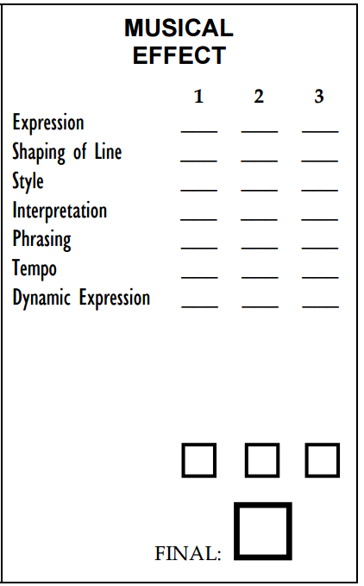

Slide 18
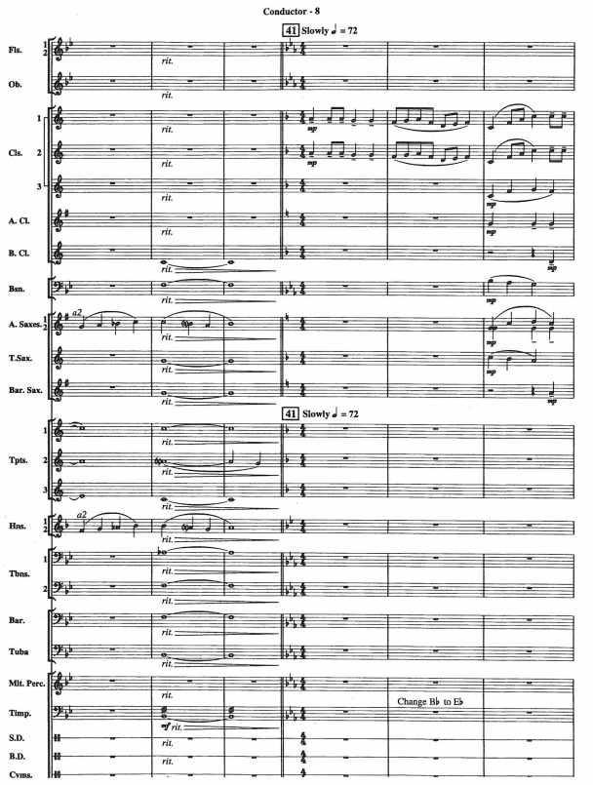
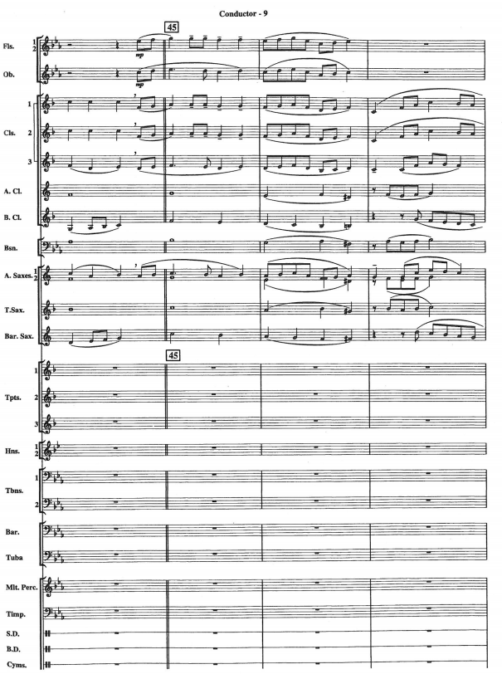

Slide 19
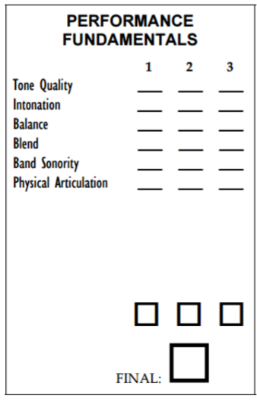

Slide 20
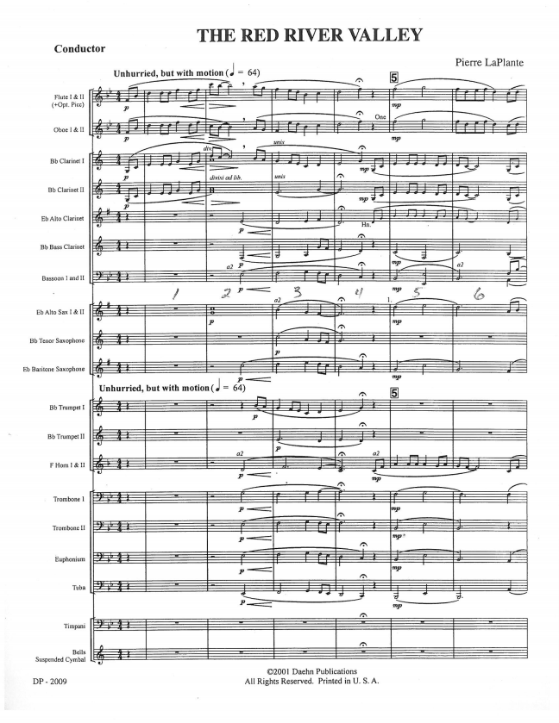
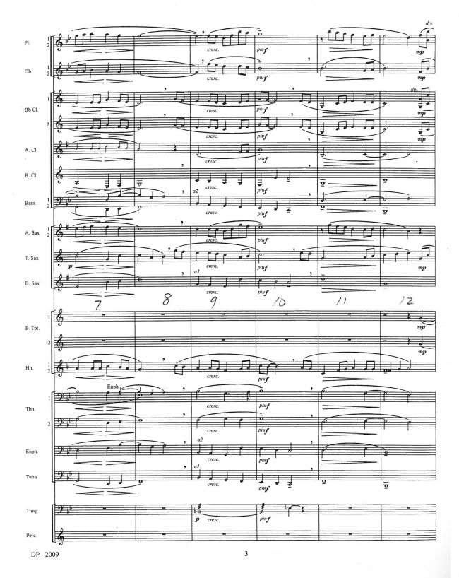

Slide 21
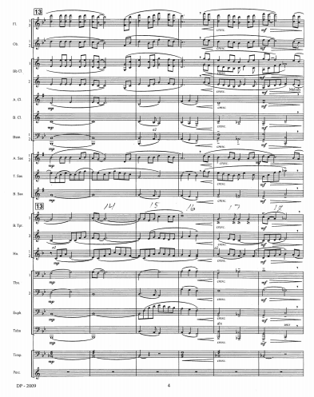
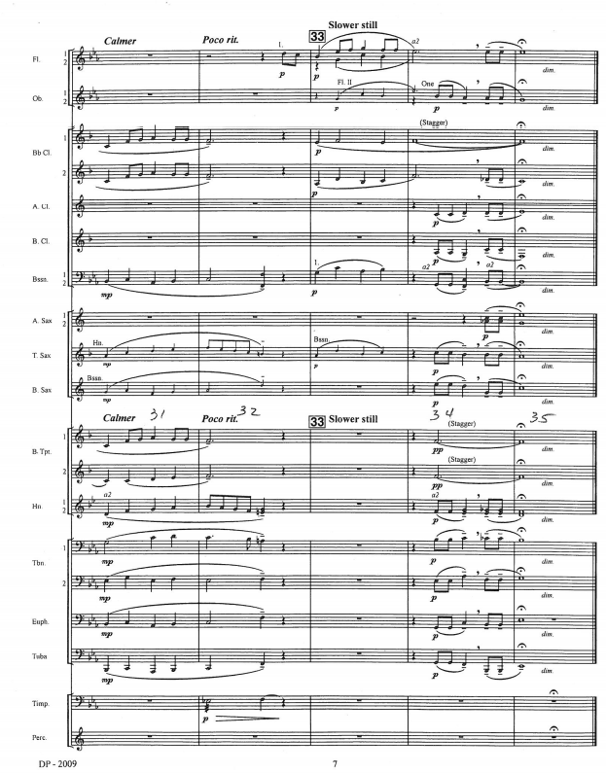

Slide 22
How To Find Success At The
Concert MPA With A
“Limited Instrumentation”
Ensemble
Presented by
Ms. Kelly Dorsey, Union County High School
Mr. Ivan Wansley, Clinician/Conductor/Adjudicator
January 13, 2017
Sponsored by The American School Band Director’s Association

