Slide 1
You Want Me to Do What
in 3 minutes?
The Concert Band Sight-Reading Experience
Presented by
Ms. Kelly Dorsey, Union County High School
Mr. Ivan Wansley, Clinician/Conductor/Adjudicator
January 14, 2016
Sponsored by The American School Band Director’s Association

Slide 2
BANDS THAT ARE PHYSICALLY INVOLVED DURING THE PREPARATION TIME
WILL HAVE A BETTER CHANCE TO ACHIEVE SUCCESS
Notes:
Ivan

Slide 3
IF YOU ARE TEACHING
BASIC FUNDAMENTALS DAILY
IN REALITY YOU ARE
“TEACHING” SIGHT-READING DAILYILY
Notes:
Ivan

Slide 4
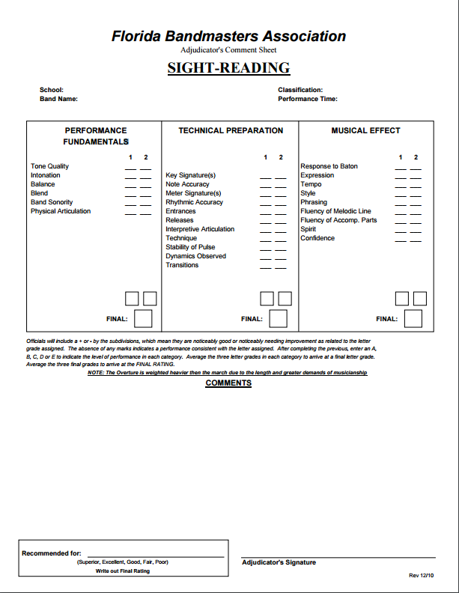
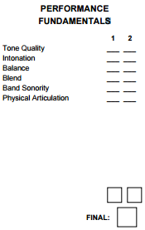
BOX 1
Notes:
Ivan

Slide 5
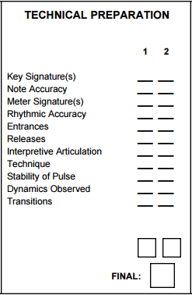
BOX 2
Notes:
Ivan

Slide 6
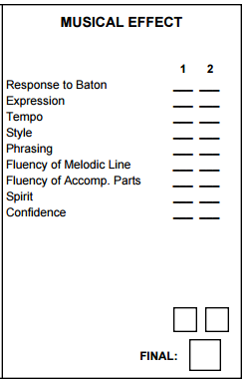
BOX 3

Slide 7
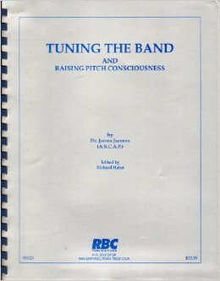
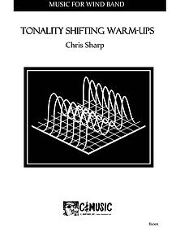
Notes:
Ivan

Slide 8

We Must
Teach Them
the Language
Notes:
Ivan

Slide 9
Tempo Terms
A Tempo - back to the original tempo
Adagio - rather slow
Allargando - gradually broadening style and slowing tempo
Allegro - a brisk lively tempo
Andante - moderately paced; at a walking pace.
Moderato - a moderate tempo that is slower than allegretto but faster than andante
Poco a poco - little by little
Presto - very fast
Ritardando - gradually getting slower
Rubato - with some freedom of time; robbed time
Stringendo - gradually getting faster
Subito - suddenly
Vivace - lively or vivacious manner
Piu Mosso - more motion
Meno Mosso - less motion
Notes:
Kelly

Slide 10

Expression Terms
Cantabile - in a singing style
Dolce - sweetly
Espressivo - expressive
Solo - one player
Soli - group of soloists; plural of solo
Subito - suddenly
Tacet - silent
Tutti - all; everyone
Unison - playing the same musical notes
Notes:
Kelly

Slide 11




Interpretive Articulation
Term Symbol Effect
Accent play with emphasis
Marcato play with heavy emphasis
Legato smoothly with no break between notes
Staccato detached
Tie to connect two or more of the same pitch
Notes:
Kelly

Slide 12









Dynamics
Term Symbol Effect
pianissimo very soft
piano soft
mezzo piano moderately soft
mezzo forte moderately loud
forte loud
fortissimo very loud
Term Symbol Effect
forte piano loud then soft
sforzando sudden accent
crescendo gradually louder
decrescendo gradually softer
Notes:
Kelly

Slide 13


“Road Map” Symbols - Terms
Terms Symbol Effect
Fine Fine Final Measure
Coda The final passage of a piece of music
Da Capo D.C. To the beginning
Dal Segno D.S. To the sign
D.C. al Fine D.C. al Fine Back to the beginning, play to the Fine.
D.C. al Coda D.C. al Coda Back to the beginning, skip to the Coda
D.S. al Fine D.S. al Fine Back to the Sign, play to the Fine.
D.S. al Coda D.S. al Coda Back to the Sign, skip to the Coda.
Notes:
Kelly

Slide 14






“Road Map” Symbols - Terms
Terms Symbol Effect
Repeat Signs Repeat the section
Measure Repeat Repeat the previous measure
1st & 2nd Endings Play the measure the 1st or 2nd time only
Caesura Complete Pause
Probable Time Signatures
quarter gets 1 beat half note gets 1 beat eighth note gets 1 beat
Notes:
Kelly

Slide 15
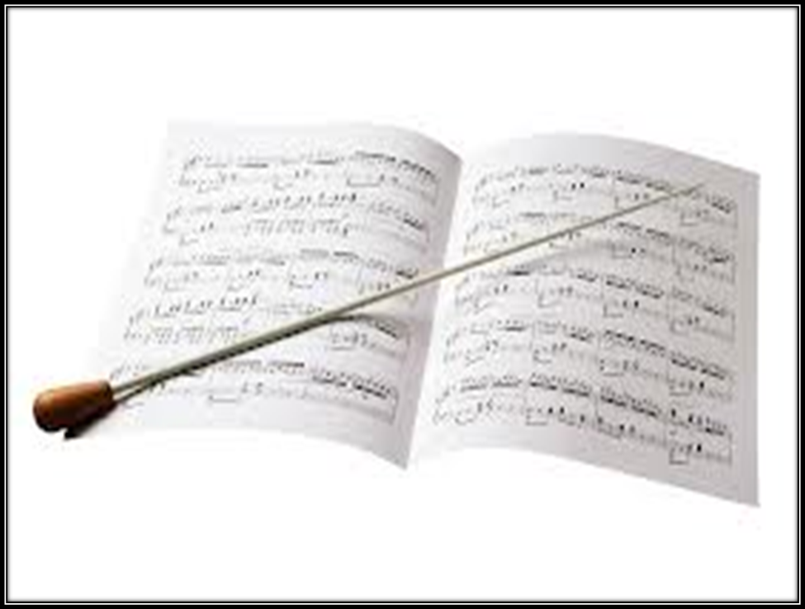
Stop using the term “Rest”
We execute “Silence”
Notes:
Ivan

Slide 16











8 basic ONE beat patterns when = 1
Variations:
Notes:
Ivan

Slide 17
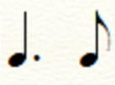



TWO beat patterns when the = 1
Notes:
Ivan

Slide 18












8 basic ONE beat patterns when the = 1
Variations:
Notes:
Ivan

Slide 19




TWO Beat Patterns when the = 1
Notes:
Ivan

Slide 20


Write it!
Count it!
Perform it!
Notes:
Ivan

Slide 21
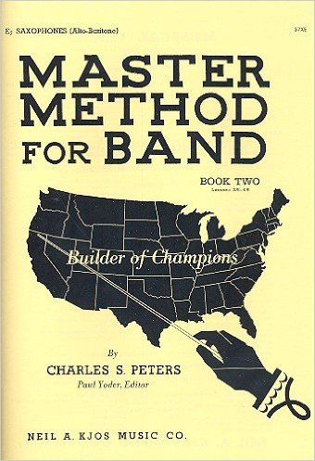
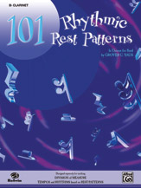
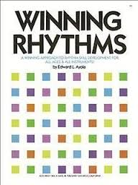
Notes:
Ivan

Slide 22
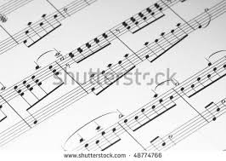
Sight Reading Room Procedures
Notes:
Kelly

Slide 23
Plan Ahead
Have percussion parts pre-assigned i.e. snare, bass, cymbals, timpani, mallets, auxiliary parts. It’s okay to double parts.
Assign a roving percussionist that does not play to stand near the snare or bass drum and communicate to them if the tempo is off - they watch the music and you.
Have your tenor sax and bassoon players sit near the euphoniums.
Consider seating alto saxes behind the french horns.
Do you sight-read on stage or in the SR room if you are the last band to perform?
Do you allow parents and spectators to come in your room?
If parents/guardians are allowed, review policies on recording the event - check handbook
Notes:
Kelly

Slide 24
Getting Settled in
If you don’t like the setup of the room, change it!
Remind Percussion to set up just like in their bandroom - review the FBA handbook to verify which instruments will be available.
Make sure ALL music is either under student’s chairs or taken up by a parent before entering the room.
Check height of stands.
Students should not play until directed to do so by their director.
Warm Up Note? Play/Sing - refer to the FBA handbook
BEFORE the adjudicator gives instructions to take out music, make sure the students have the correct parts.
All eyes on the adjudicator.
When the adjudicator instructs to “reach into your folder….”, students should begin immediately scanning their parts.
Notes:
Kelly

Slide 25
Road Map
Time Signature
Key Signature
Dynamics
Endings and Repeat
Time Changes
Tempo Changes
Key Changes
Fermatas
Caesuras
Dal Segno
Da Capo
Coda
Fine
Notes:
Kelly

Slide 26


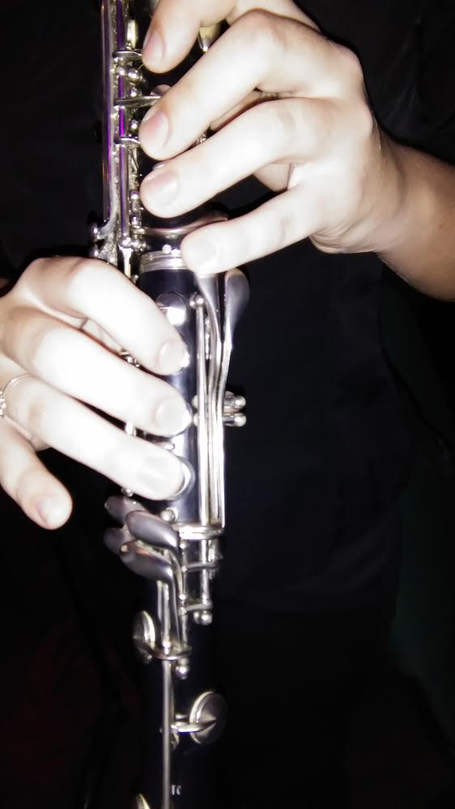
Play it before you Perform it….What???
Clap?
Sizzle?
Sing!
Notes:
Both

Slide 27
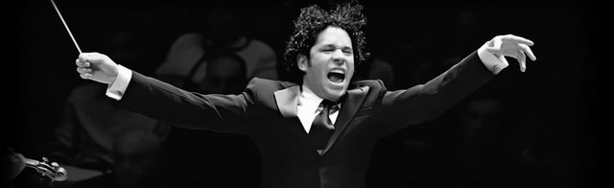
Conducting Techniques
Always breathe with the ensemble.
Make the prep beat in the tempo of the piece.
Large downbeats at the beginning of main phrases or sections.
Hold up 1 finger for 1st time through, 2 fingers for 2nd time through, etc.
Don’t be afraid to be musical.
Notes:
Ivan

Slide 28
General things to look for in a March
Style - separated notes
Tempo - average 112 bpm
Counter Melodies - often in the euphonium/trombone/tenor sax parts
(sometimes written in the score as very small cued notes).
Trio - add a flat or take away a sharp, style is generally smoother and softer.
1st & 2nd Endings - some individual parts may or may not have endings.
Percussion parts - bass drum/crash cymbals - bass drum/tuba
Notes:
Ivan

Slide 29
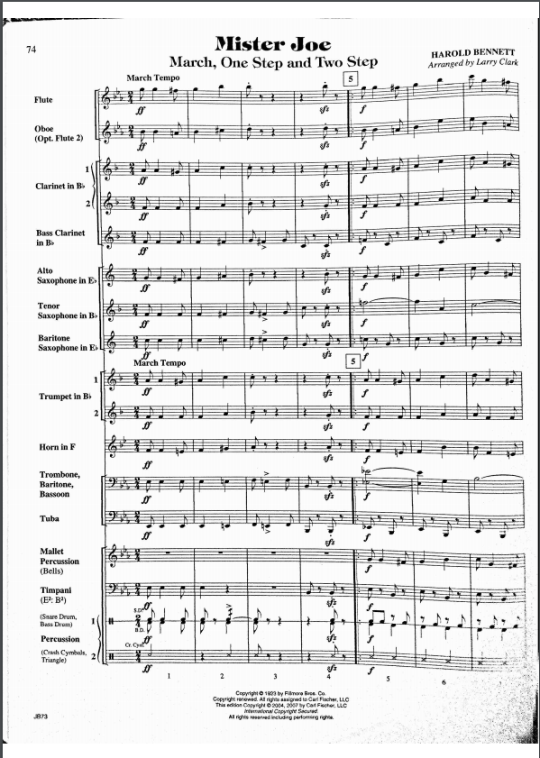
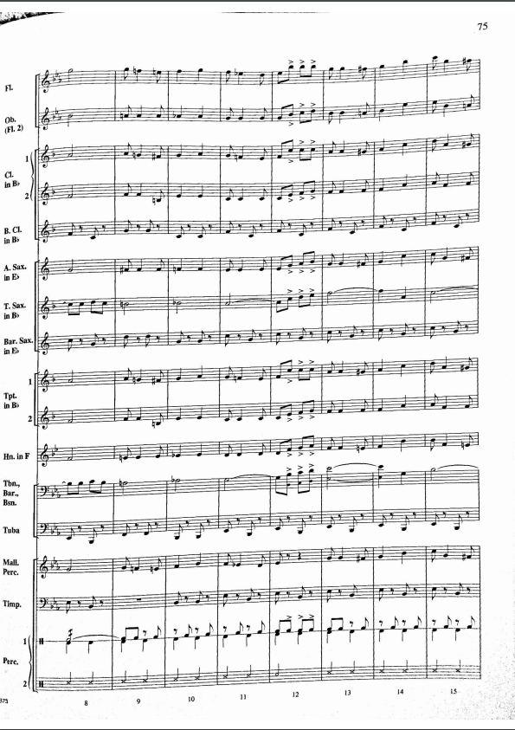
Notes:
Ivan

Slide 30
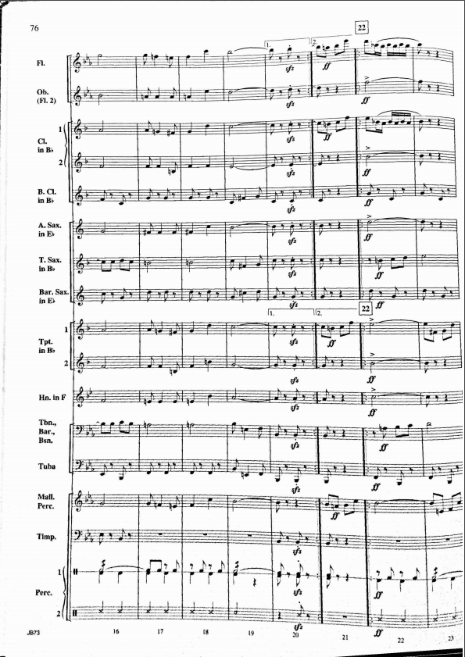
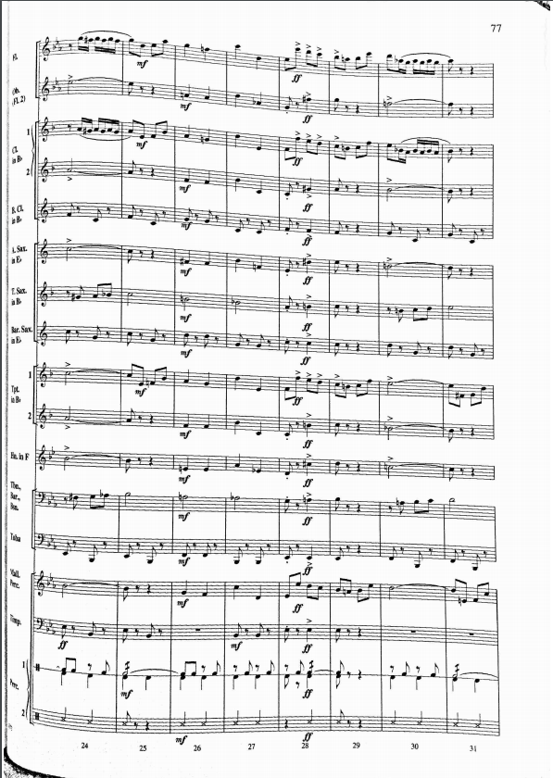
Notes:
Ivan

Slide 31
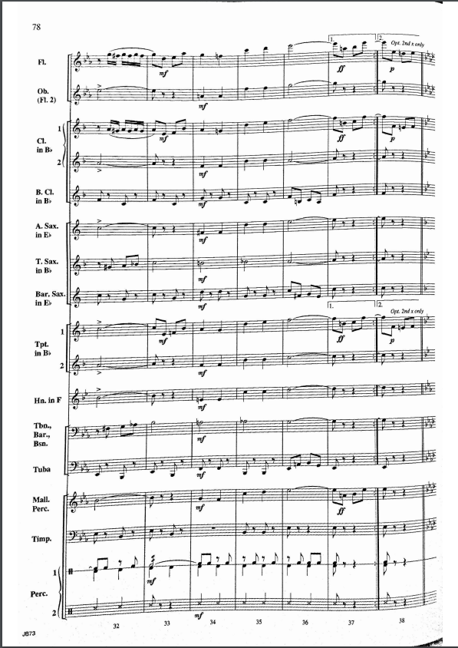
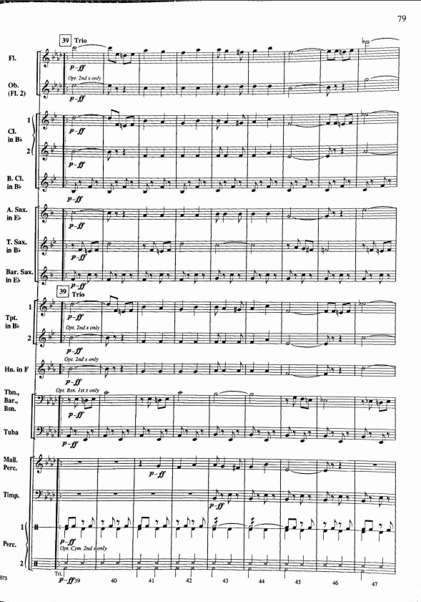
Notes:
Ivan

Slide 32
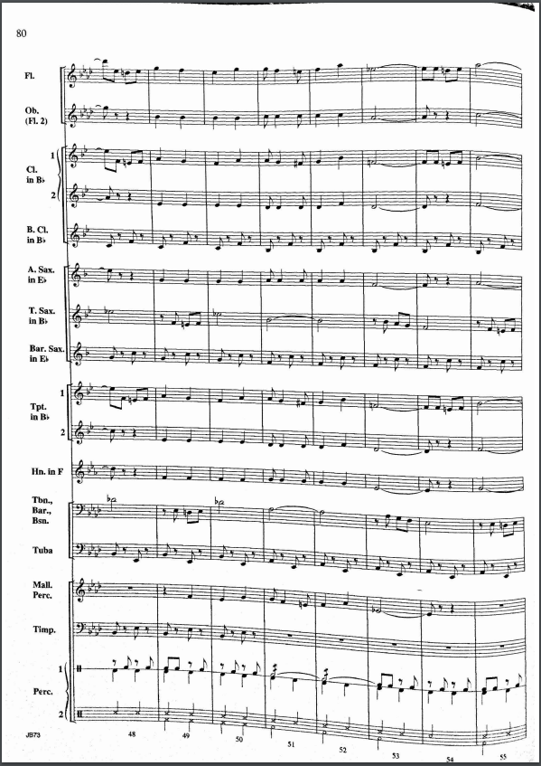
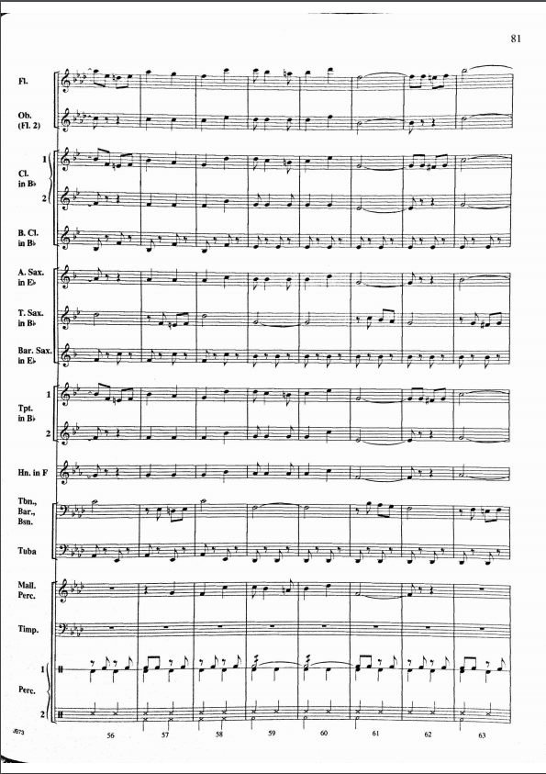
Notes:
Ivan

Slide 33
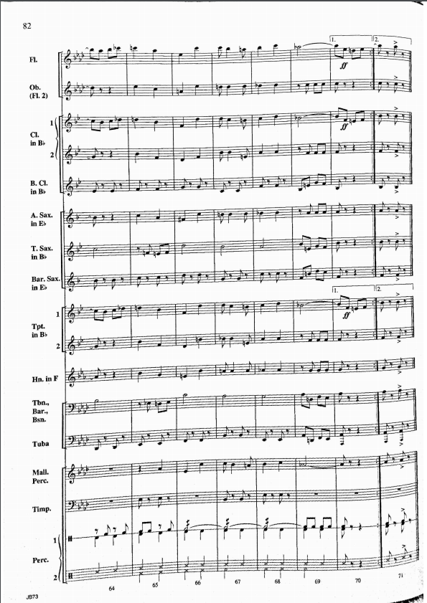
Notes:
Ivan

Slide 34
General things to look for in the Overture
Things that will change throughout the piece: Time Signatures, Key Signatures, and Tempos.
Be sure to go over the End of the piece BEFORE you run out of time.
Have the Judge or a student give you time warnings on the minute.
Make sure the students know when they have the Melody.
Percussion Soli.
Notes:
Kelly

Slide 35
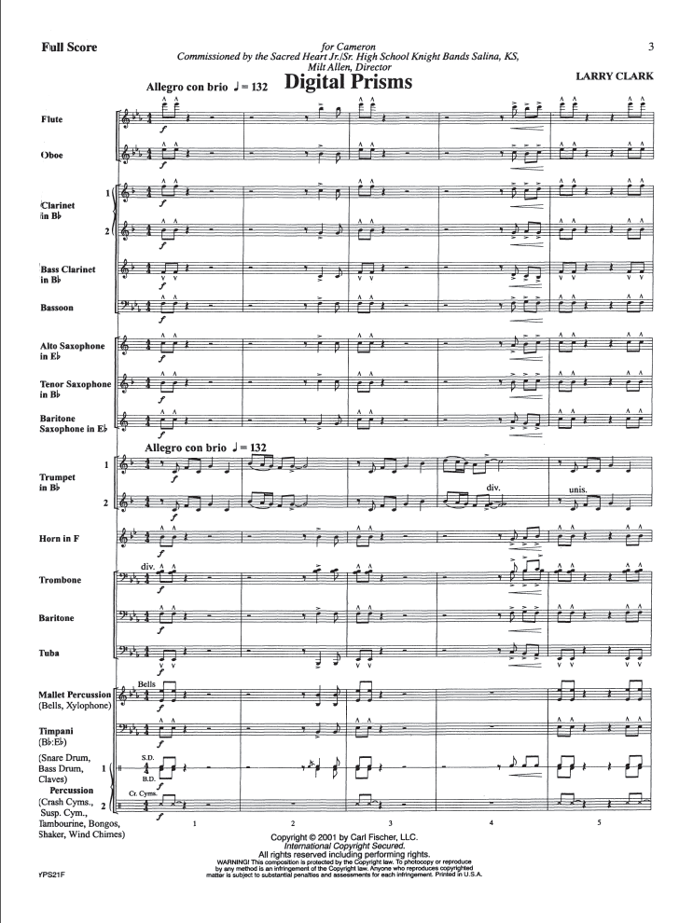
Notes:
Kelly

Slide 36
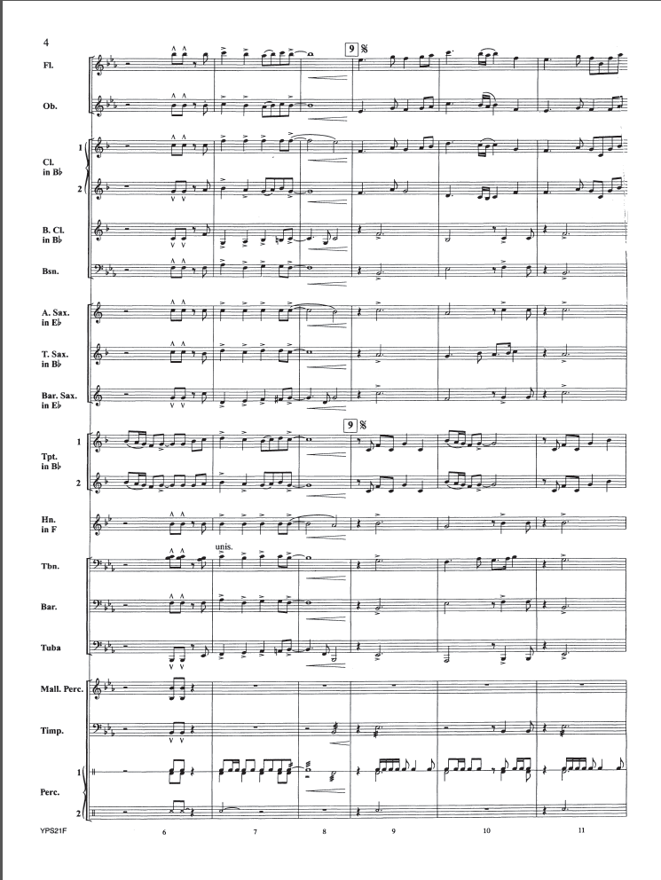
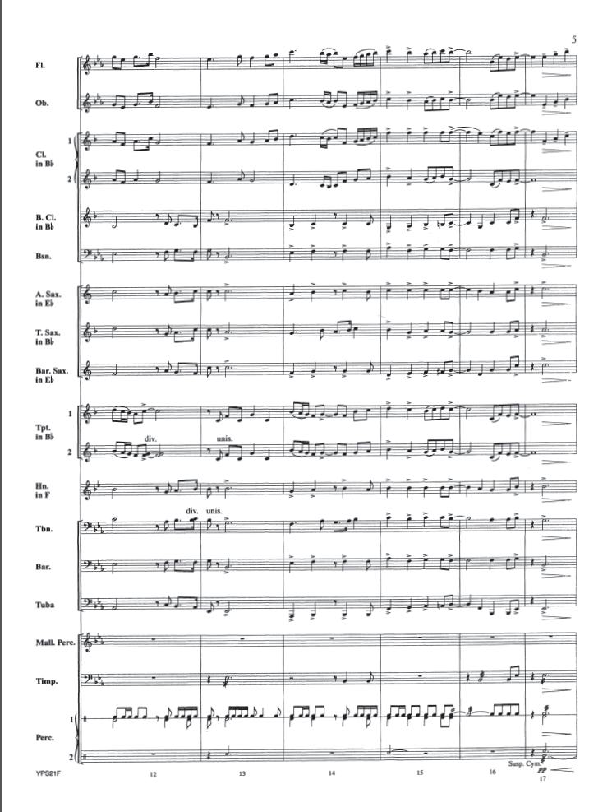

Slide 37
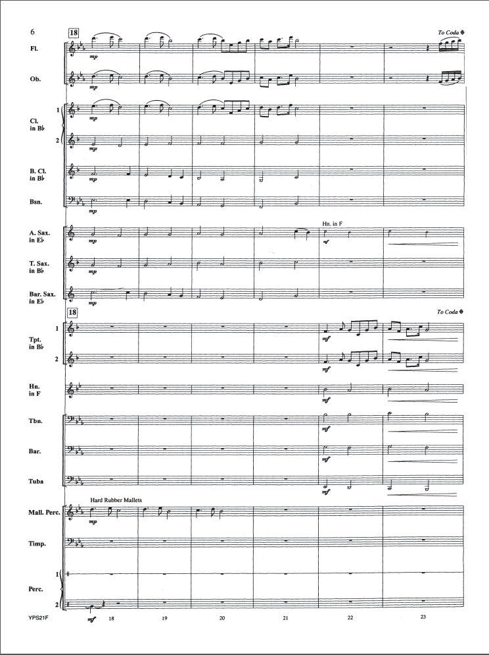
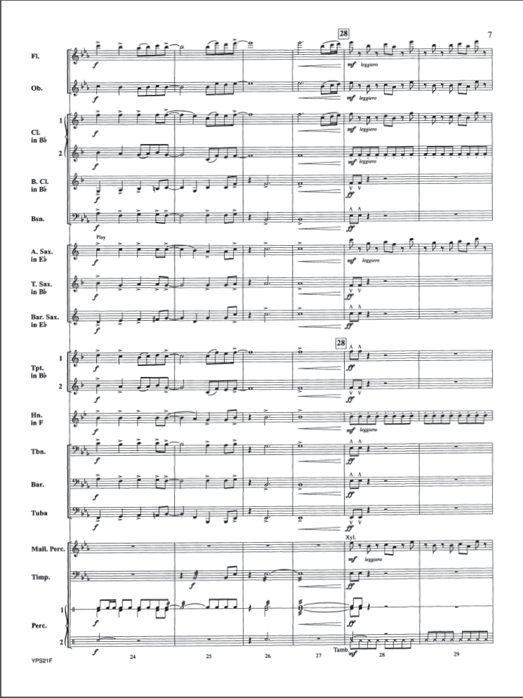

Slide 38
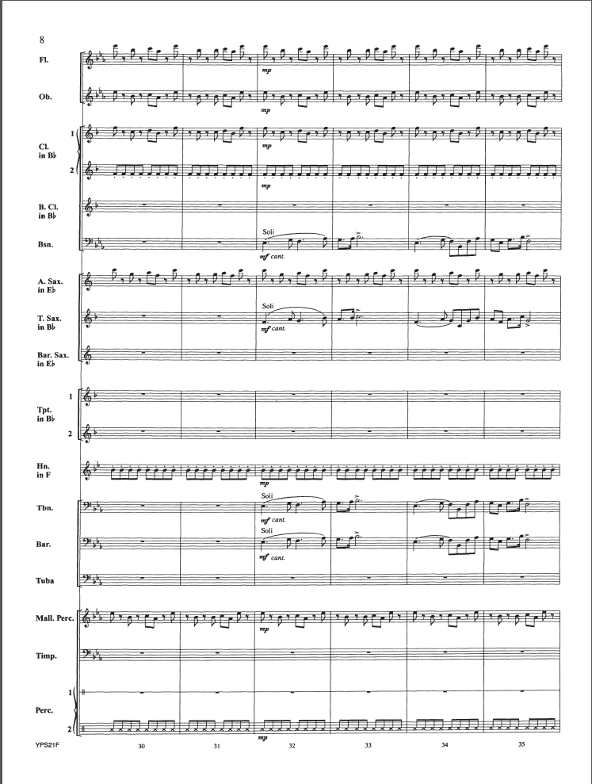
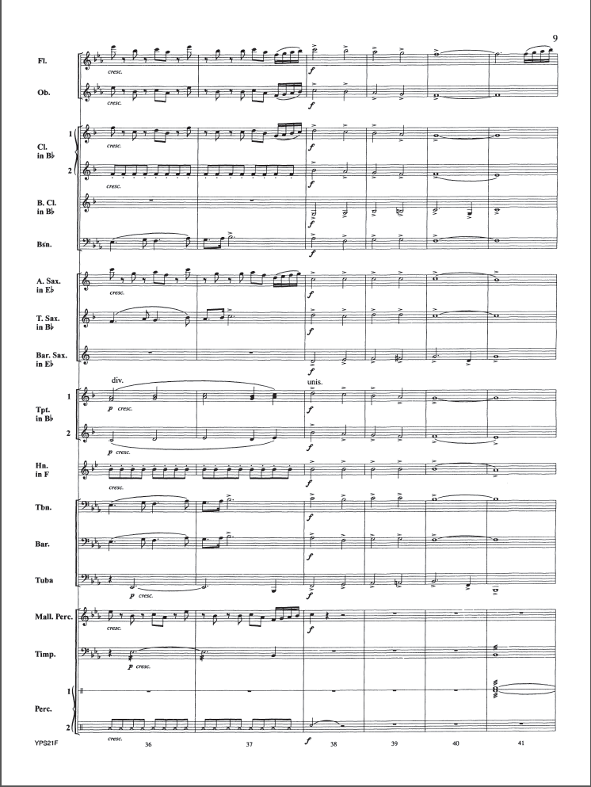

Slide 39
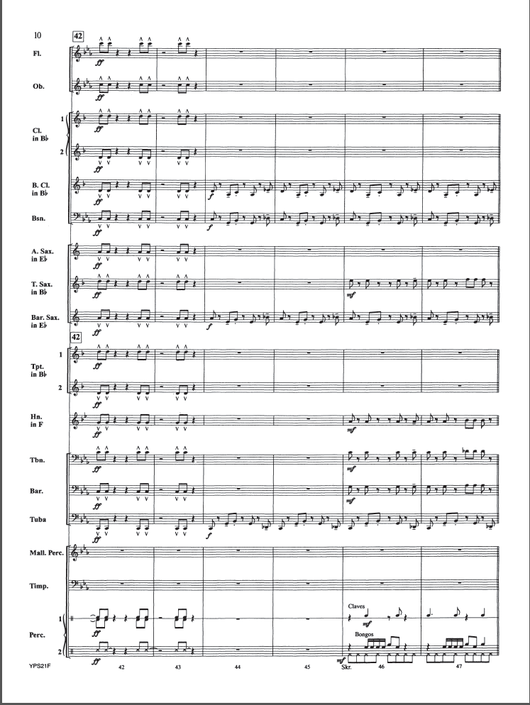
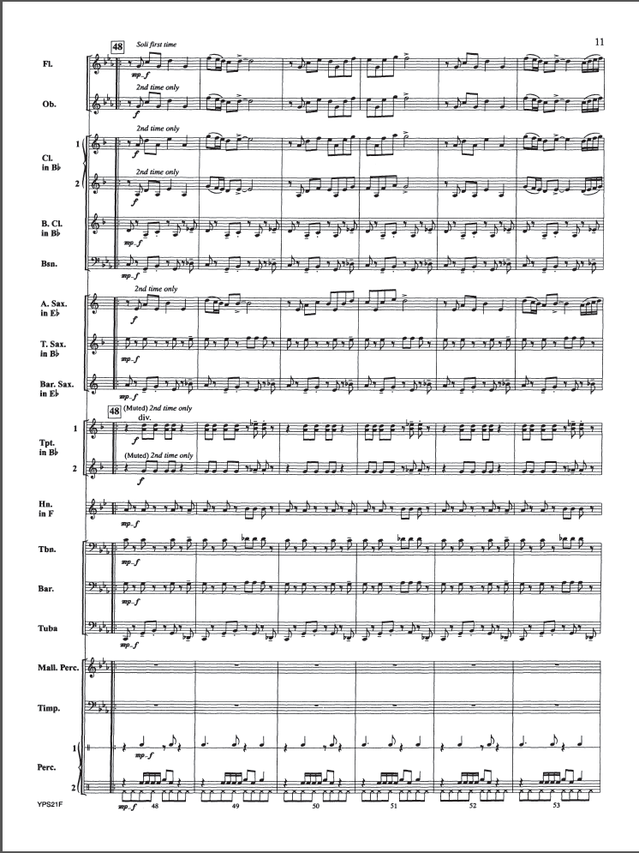

Slide 40
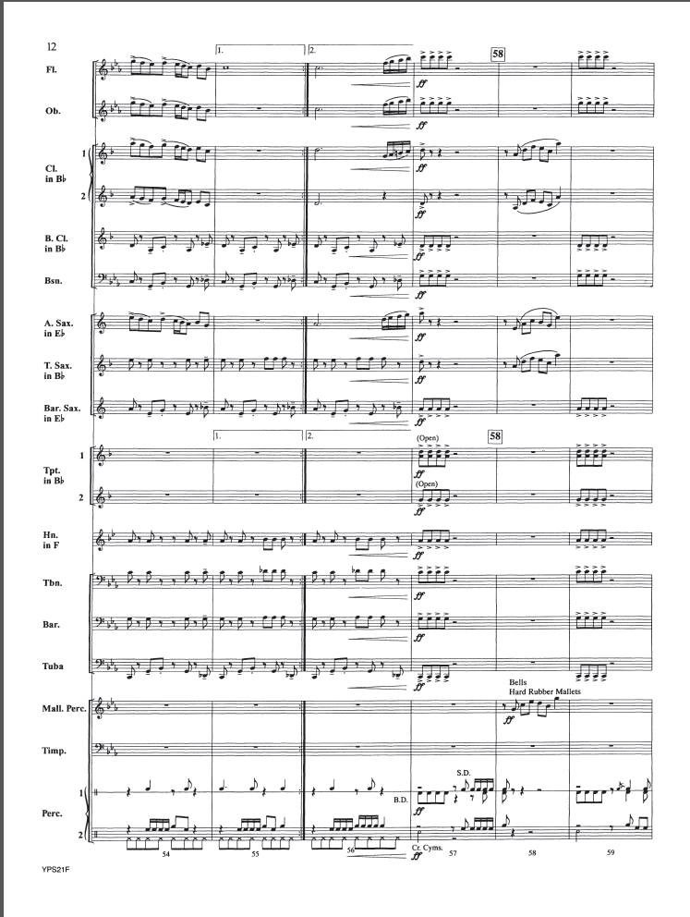
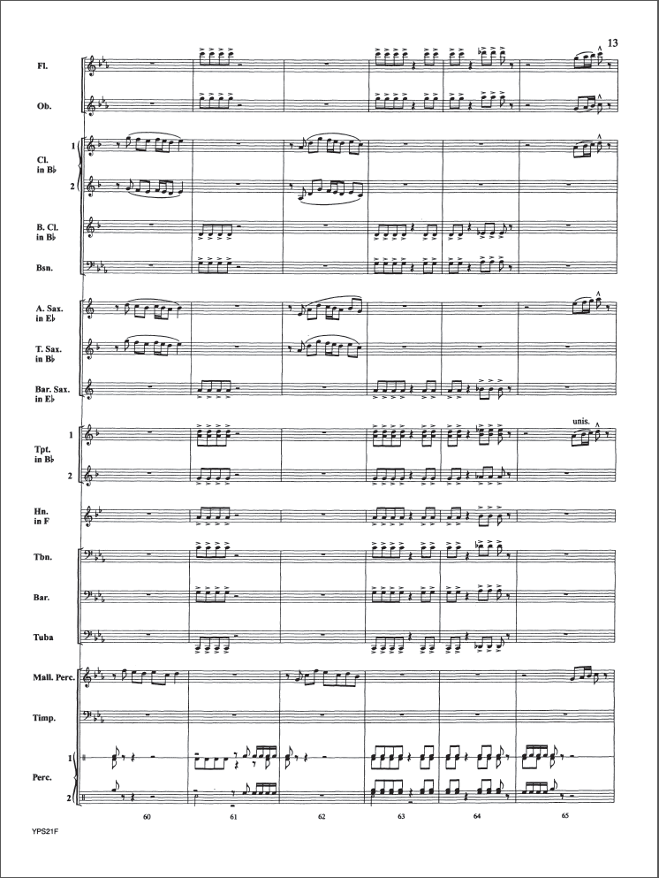

Slide 41
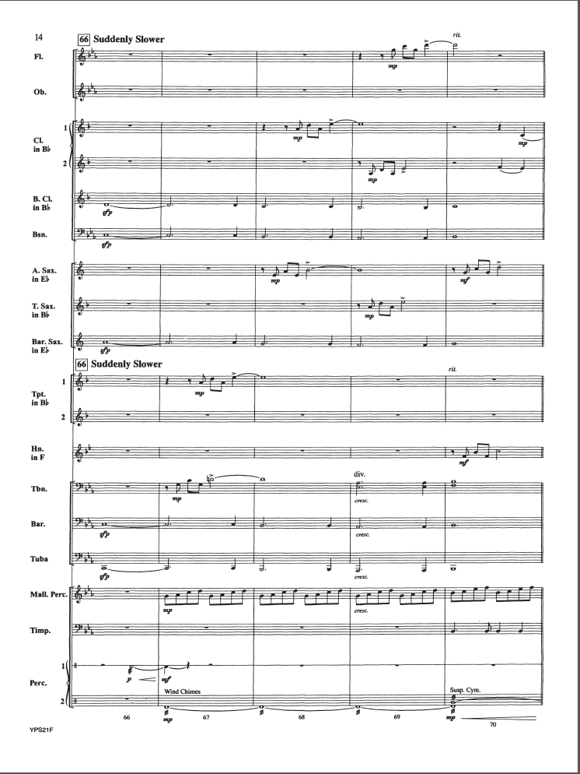
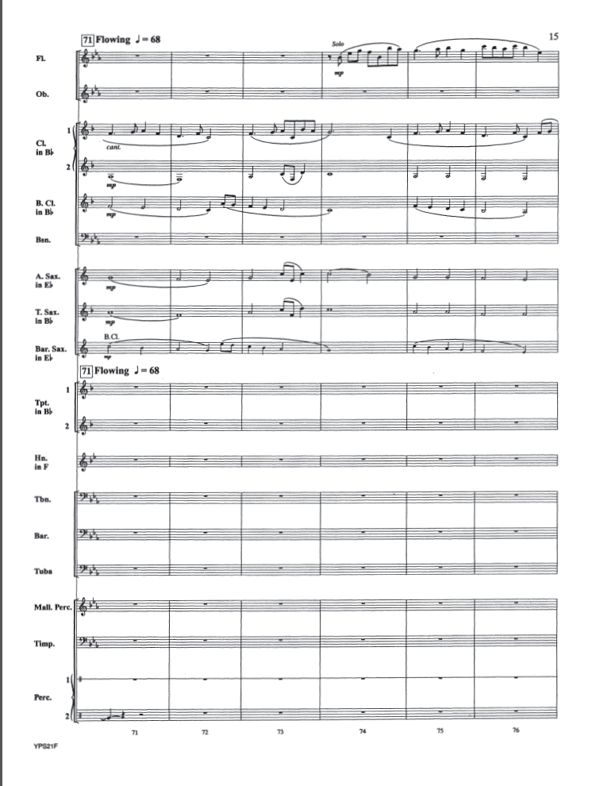

Slide 42
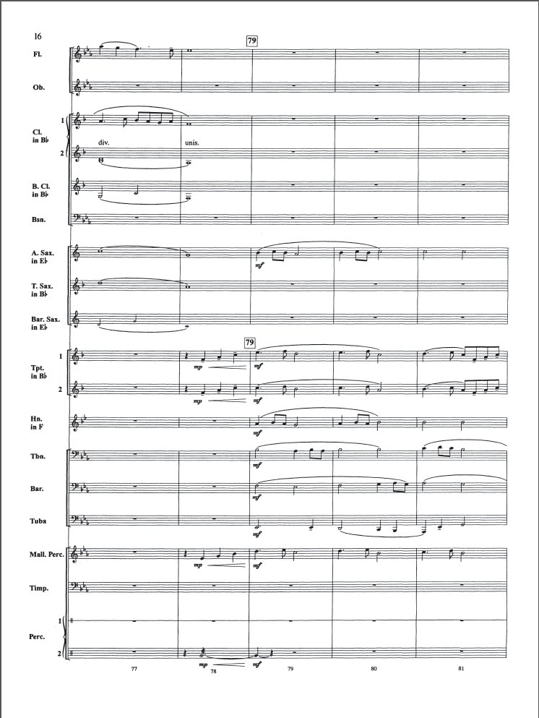
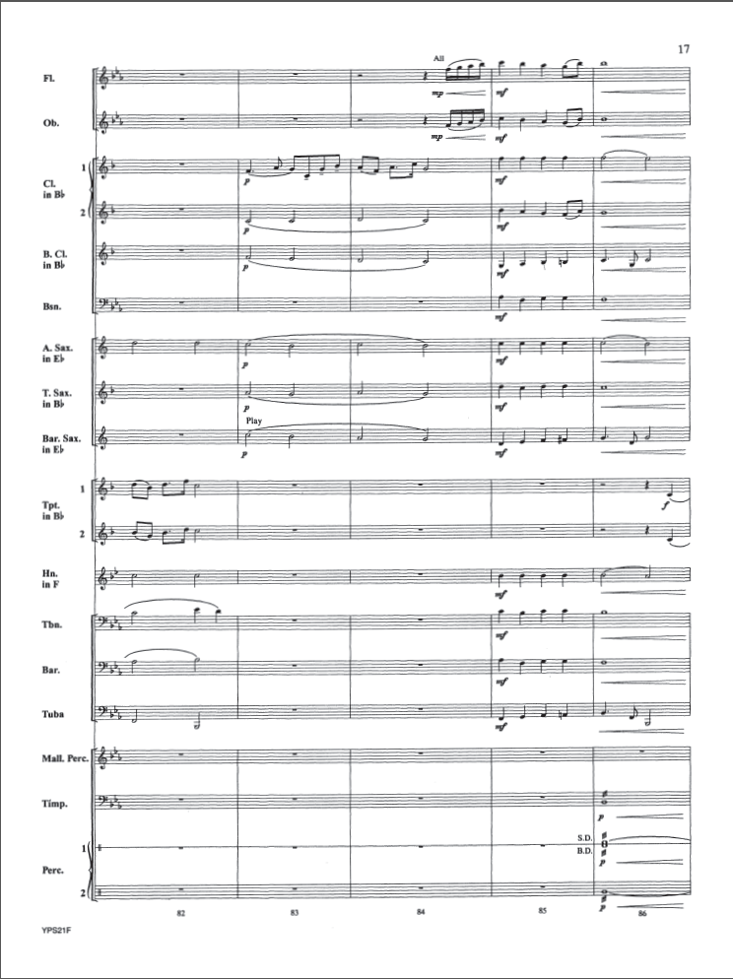

Slide 43
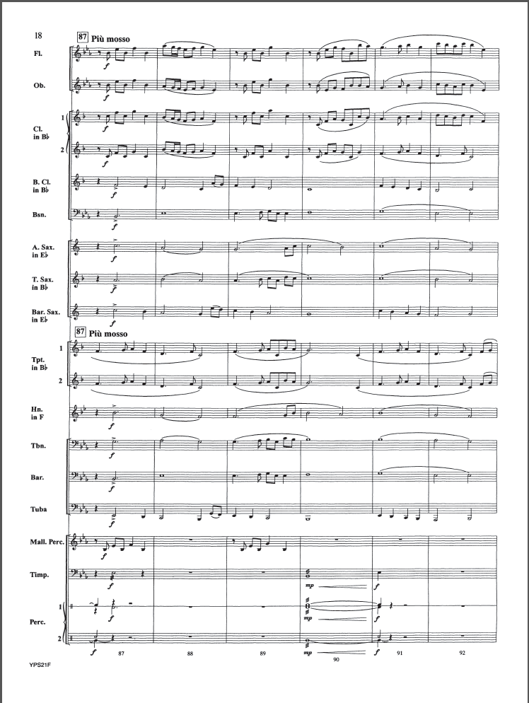
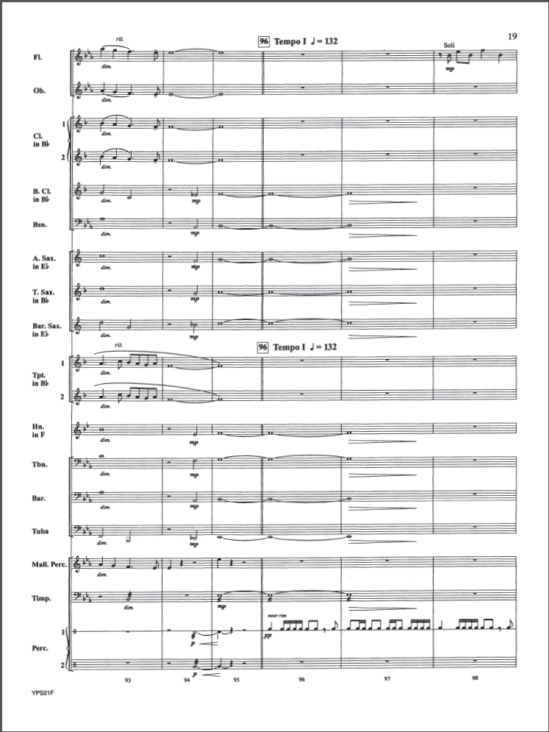

Slide 44
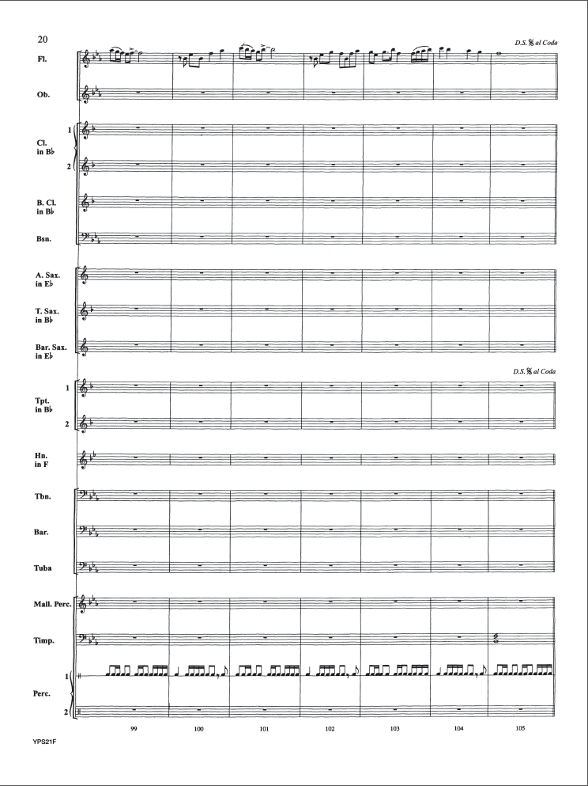
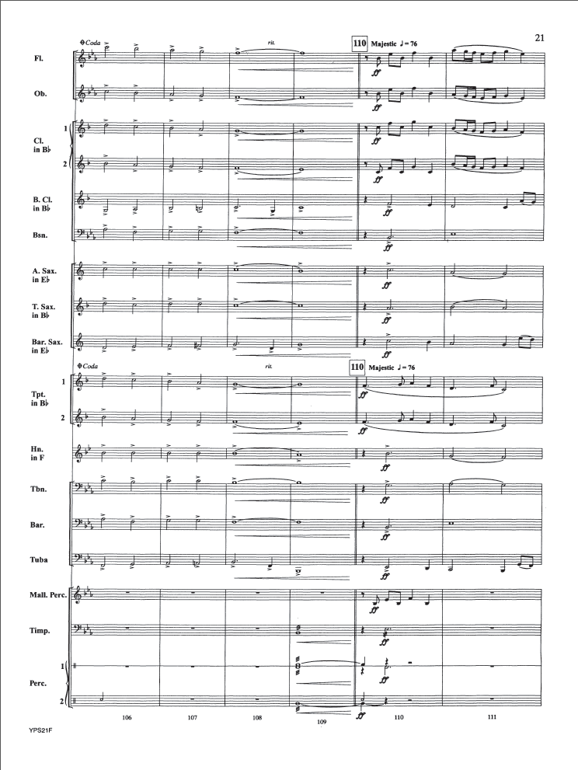

Slide 45
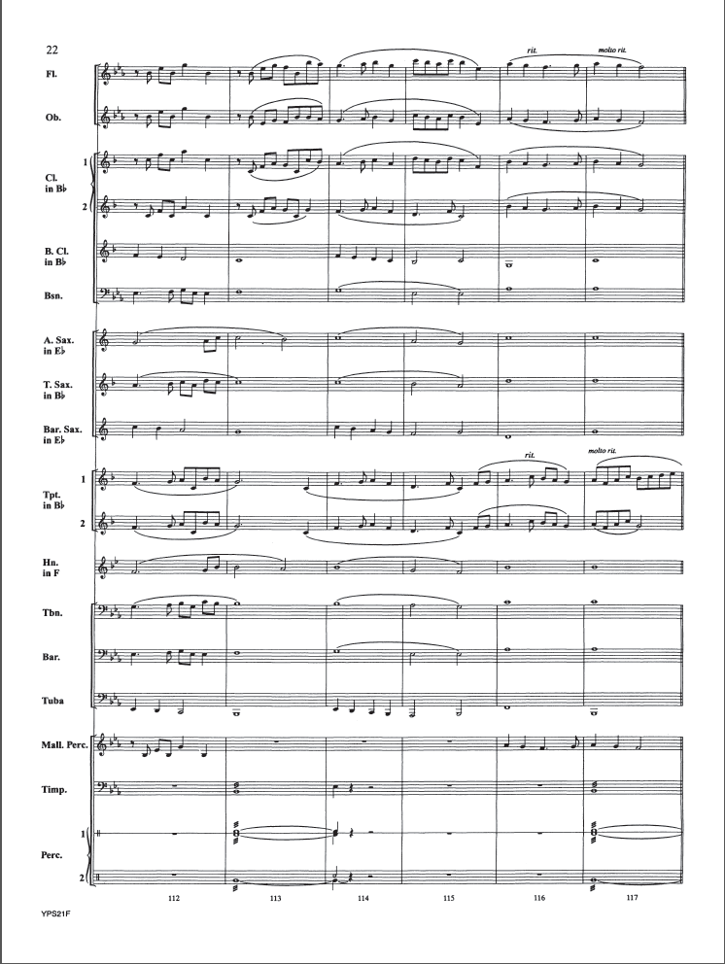
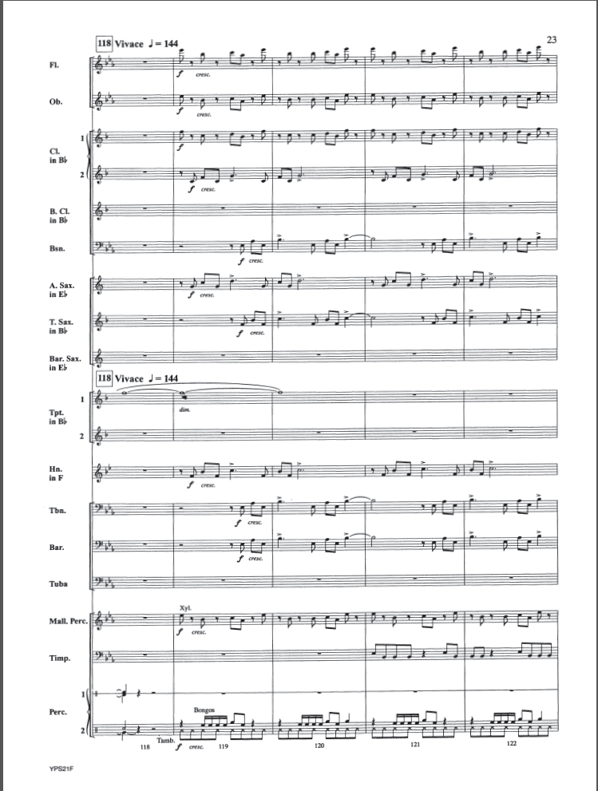

Slide 46
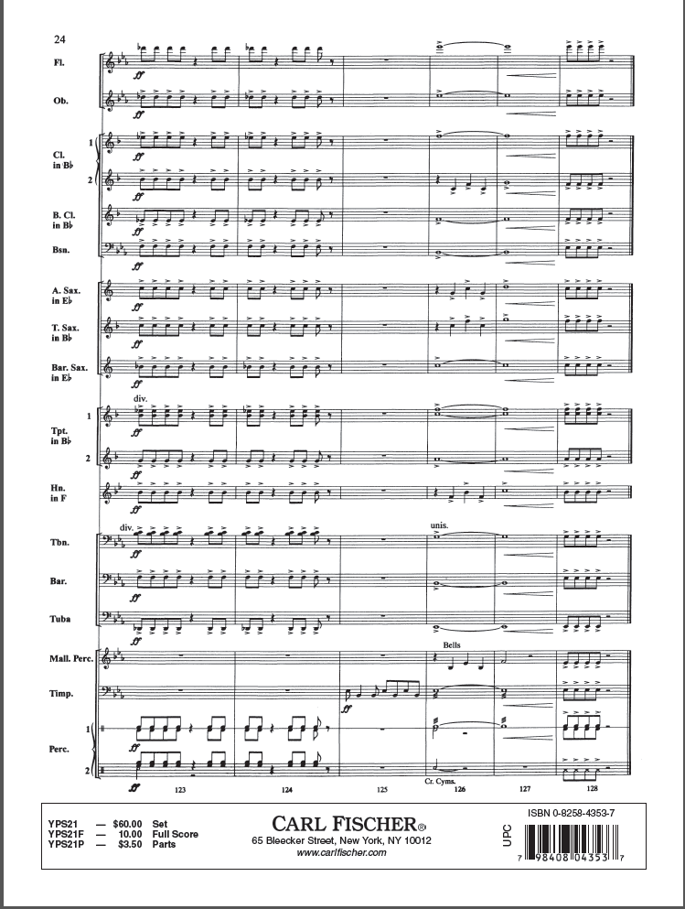

Slide 47
Materials
Notes:
Ivan

Slide 48
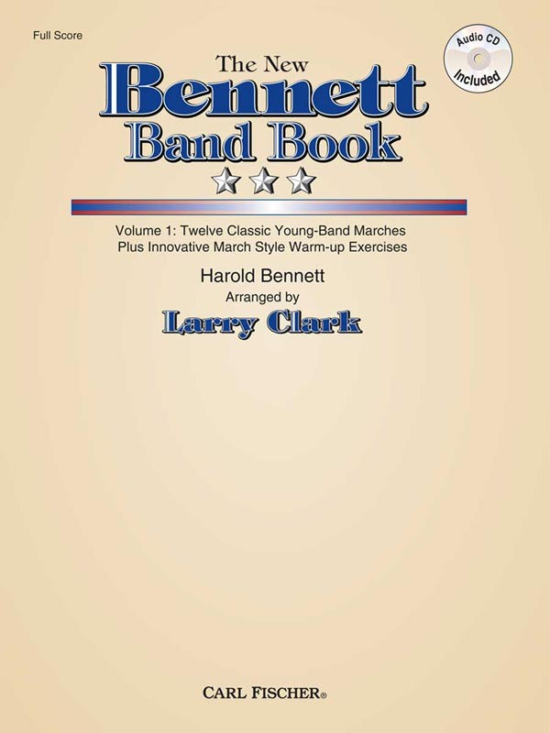
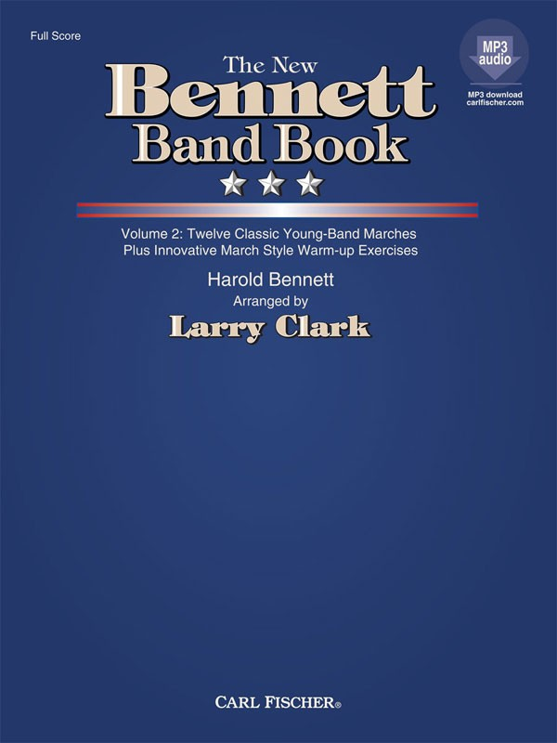
Notes:
Ivan

Slide 49
Final Thoughts
When practicing the sight reading procedure in your classroom, don’t forget to go back and review areas where students struggled. Otherwise, they are only learning the procedures and not from their mistakes.
Learning our scales is not enough. We must practice reading in each key signature.
There is no way to anticipate exactly what you will get in the sight reading room. Preparing for as many scenarios as possible is always the best policy.

Slide 50

Thank You
Larry Clark, Editor-in-Chief and Vice President of Carl Fischer Publishing
Florida Chapter of the American School Band Director’s Association
All of you for being here!

