Slide 1


How To Fix It - Part 2
The American School Band Director’s Association
FMEA Clinic 2018
Clinicians
Kelly Dorsey
Alex Kaminsky
Ivan Wansley

Slide 2
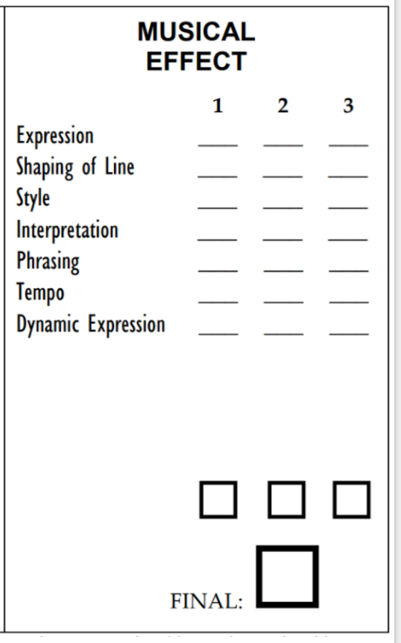
Presented by Kelly Dorsey

Slide 3
Expression
What are the implied effects in the composition?
Joyful
Sad
Noble
Intimate
Heroic
Aggressive
“From Skill to Art” by Bobby L. Adams
Play what isn’t written on the page!

Slide 4
Expression
What is the Emotional Character of the composition?
Drive
Interruptions
Anticipations
Pauses
Sighs
“From Skill to Art” by Bobby L. Adams
Play what isn’t written on the page!

Slide 5
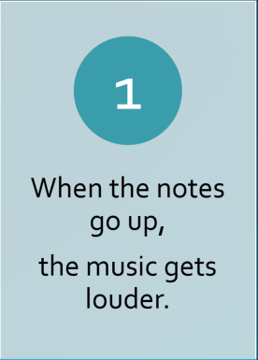
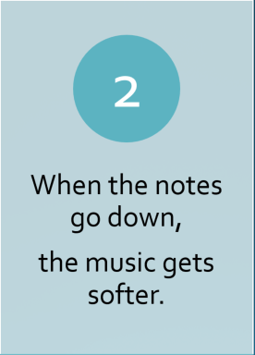

Shaping of Line
Notes:
Excerpt #1 – Clarinets at the beginning. THEN Excerpt #2 - oboe/clarinets measure 26 & 27

Slide 6
Shaping of Line
** In a 3/4 time signature, the weight is almost always on beat one.

Slide 7
Shaping of Line
Determine the climax of each phrase.
Shape the line according to the weight of the note rather than the shape of the up and down line.
What note are you going to?

Slide 8
Understanding Roles
The Melody shall always be heard.
The Harmony shall always be heard but never, never, cover the Melody.
The Rhythm shall be felt.
The long notes (drone) shall never cover the rhythm.
Notes:
Excerpt #4 - only play when you have the melody measure 45

Slide 9
Understanding Roles
Each player
defines their role.
Match like parts in sound
and interpretation
Balance according to
the part you have.
Bring out moving parts
then get out of the way.

Slide 10
Phrasing
Decide when to release phrases and when to pass the baton.
Dovetailing of lines: If one group or person is playing, don’t release their note until the next group enters.
Don’t breathe after a long note or over a barline unless it is the end of a phrase.

Slide 11
Tempo
Play at the tempo your band can play well
Don’t play slow pieces too slowly
Don’t play fast pieces too fast
Rubato - don’t be afraid to use this.
There is almost always a variation of tempo.
Notes:
Measure 26 - ALL play with Rubato

Slide 12
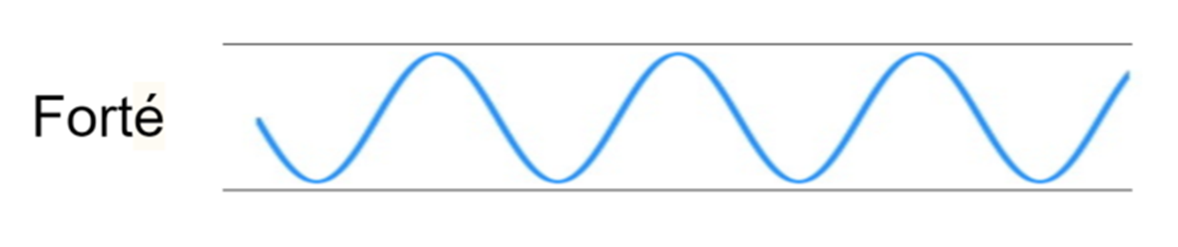

Dynamics

Slide 13
Interpretation
Listen to multiple recordings until you learn the sound of the piece in your head that you want.
Study your scores and anticipate rehearsal errors. Make your marks ahead of time.
Record your ensemble daily. Make sure you are hearing what they are actually playing. Don’t settle!

Slide 14
Interpretation
Let the kids play without a conductor and make their own musical decisions.
However you choose to interpret a piece, it should be done in a unified manner. If the 40 piece ensemble has different notes lengths and different approaches to a line, it will be a mess.

Slide 15
General
Comments
Get on the kid’s level to explain it.
Make sure they are doing what you told them to do. Don’t just say: ”I told them that”. Repeat it over and over until you get what you want.
Break it down to one player or section to demonstrate what you want, then have the ensemble match them.

Slide 16

Play with a good sound
and make music!

Slide 17

HOW TO FIX IT
Presented by Alex Kaminsky

Slide 18
What’s broken?

Slide 19

Fundamentals!

Slide 20
Performance Fundamentals
Tone Quality
Intonation
Balance
Blend
Band Sonority
Physical Articulation

Slide 21
Break it down:

Slide 22
Break it down:
Tone Quality

Slide 23
Break it down:
Tone production is of moderate quality and lacks consistency.

Slide 24
Break it down:
Tone Quality
Intonation

Slide 25
Break it down:
Breath support is sometimes used correctly to produce characteristic tones; however, there are frequent intonation discrepancies within and across sections.

Slide 26
Break it down:
Tone Quality
Intonation
then, you can…

Slide 27
Break it down:
Tone Quality
Intonation
Balance

Slide 28
Break it down:
Performers sometimes achieve proper balance.

Slide 29
Break it down:
Tone Quality
Intonation
Balance
Change priority to...

Slide 30
Break it down:
Balance (Air/Volume)
Tone Quality
Intonation
which allows for…

Slide 31
Break it down:
Tone Quality
Intonation
Balance
Blend

Slide 32
Break it down:
Achievement of blend is limited due to timbre differences caused by poor tone production.

Slide 33
Break it down:
Tone Quality
Intonation
Balance
Blend
which leads to…

Slide 34
Break it down:
Tone Quality
Intonation
Balance
Blend
Band Sonority!

Slide 35
Break it down:
The band sonority suffers because there are frequent harsh or pinched tones due to players’ inability to control tone quality and intonation in extreme ranges/volumes.

Slide 36
“HOW TO FIX IT”
PROJECT MARCH
Bennett/Clark
Presented by Ivan Wansley

Slide 37
MARCH STYLE
March style equals “detached” – Charles Quamby
Prepare an accent (>) with silence – “prepare” the accent – Charles Quamby
Contrasts on strain repeats – Joseph Kreines

Slide 38
Format for a standard American March
4 bar introduction
16 bar 1st strain with repeat
16 bar 2nd strain with repeat
32 bar trio

Slide 39
Recommendations for marches that follow (or comes close) the basic march style – appropriate for middle and high school bands
Bennett Band Book (Henry Fillmore) – Volume 1 - Bennett/Larry Clark
Bennett Band Book – Volume 2 – Bennet/Larry Clark
Karl King March Books

Slide 40
Specific for middle school bands – all levels
The Lone Eagle – Edmondson
Omega March – Edmondson
Valley Forge March – Edmondson
Eagle Command March – Hilliard
Baywood March – Lee
Cold Brook March – O’Reilly
Maritime March – O’Reilly
Woodlake March – O’Reilly
Union March – Rogers
South Hill March – Vertoske
Swashbuckler’s March - Williams

Slide 41
PLAY THE MARCH LIKE A CHORALE AND THEN PLAY THE CHORALE IN MARCH STYLE
Remember – must hear all the harmony and get a quality sound. Never forget “Tone Quality” should always be your primary focus.

Slide 42
CHECK ALL CADENCE POINTS TO MAKE SURE THE CHORDS ARE SCORED IN SUCH A WAY THAT YOU CAN HEAR ALL OF THE HARMONY INDICATED ON THE SCORE

Slide 43
How To Fix It - Part 2
The American School Band Director’s Association
FMEA Clinic 2018
Clinicians
Kelly Dorsey
Alex Kaminsky
Ivan Wansley

